Slide 1

Cell Phone Safety
Captain Best, Lexington Police Department

Slide 2
Issue
The widespread use of smartphones helps users stay connected, but also raises privacy concerns. According to a 2018 study by the Pew Research Center, 95% of teens have access to a smartphone, and 45% say they are online “almost constantly’.
Smartphone apps let teens go online, watch videos, and game with friends, but teens most commonly use their phones to send and receive text messages. Additional Pew research notes that teens reserve voice calls for their closest friends and prefer to use text messages for newer friends and acquaintances. The research also suggests that the omnipresence of smartphones helps strengthen friendships, with 62% of smartphone-owning teens reporting that texting allows them to keep in closer contact with close friends. Additionally, having internet access via a smartphone may help teens make and maintain new friendships, with 57% reporting having made new friends online

Slide 3
Issue
Of course, near constant connectivity also poses a unique set of risks, for example, cyberbullying. Another risk that has gained national attention is sexting and sextortion. The ubiquity of cellphones has given rise to sexting as a way for teens to explore their sexuality, though in some cases these images are used against the sender as sexual blackmail.
Additionally, as most smartphones have GPS technology, users may unintentionally share their locations with the public. If a users’ photos have GPS location-tags or if a user “checks-in” to restaurants, airports, new cities, etc., friends and followers can see exactly where that person is or has been. Each smartphone brand or model may have a different way to turn off location-tracking services. Check the settings on your child’s phone, paying attention to which applications can access location data.

Slide 4
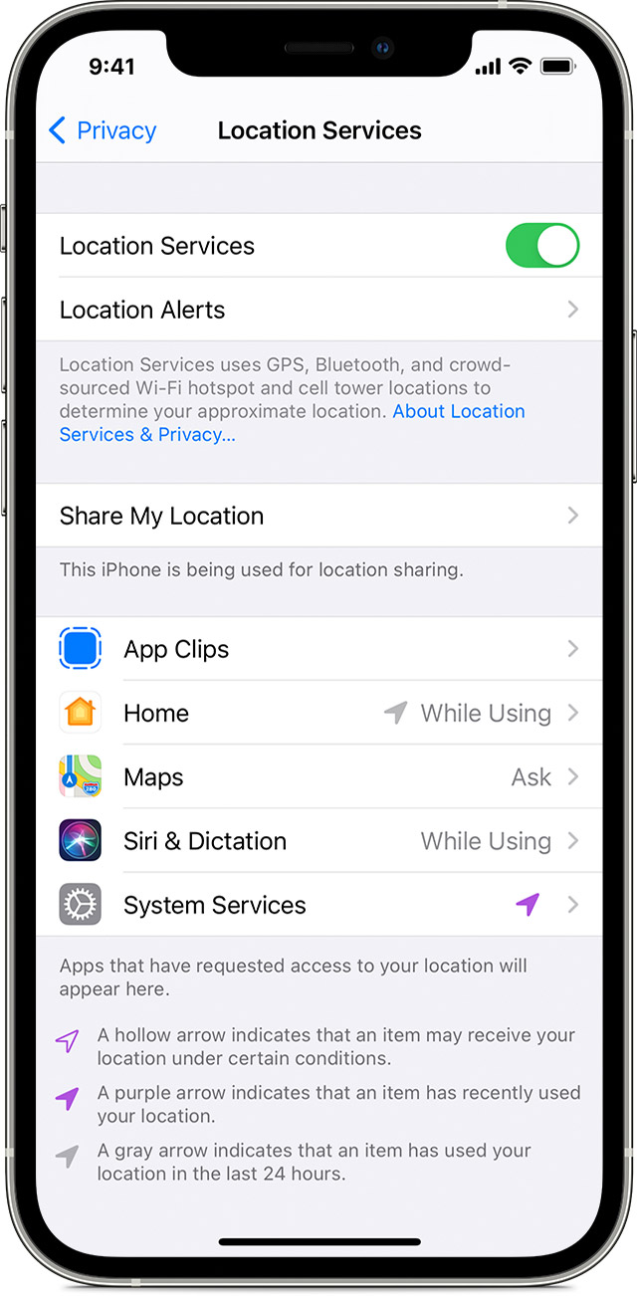
Iphone
Go to setting
Privacy
Locations Service

Slide 5
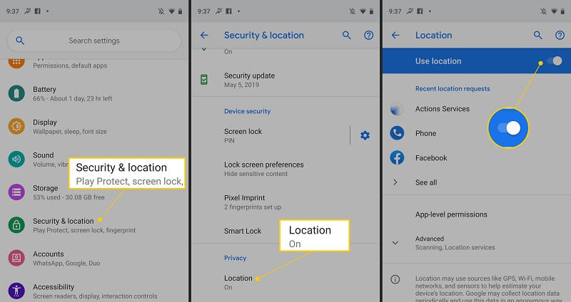
Android
Settings Menu
Security & Locations
Locations
Use locations

Slide 6
Numbers
97% of American girls, and
95% of American boys today have access to a smartphone.
In 2015, the average teen sent and received 67 text messages per day.
The average age at which a child gets a cellphone in the U.S. is 10 years old.³

Slide 7
How to Talk About It
Cellphones have changed the way we communicate. Help children and teens be safer and smarter while using their phones.
What do you use your phone for the most? Can you show me some of your favorite apps?
Do you know everyone you have as a contact in your phone and on different apps?
Has anyone ever taken an embarrassing picture of you without your permission?
Have you ever taken an embarrassing picture of someone else? What did you do with it?
Have you ever talked with someone you first met online on your cellphone?
What would you do if someone sent you a text or picture that was inappropriate?
Do you know how to turn off GPS and turn on privacy settings for the different apps you use?

Slide 8
Reinforce
Expectations and guidance for when children are allowed to use their cellphones, what websites they can visit, and what apps they can download.
The important of privacy. Know an app’s purpose before your child downloads it. Who are the users? What type of privacy settings are available?
The idea that anything a user sends from their phones can be easily forwarded and shared.
The possible consequences of sending sexually explicit or provocative images or text messages with their phones.

Slide 9
Protecting Your Kids
Connect
Set some ground rules-Establish clear guidelines like what types of sites kids can visit, apps they can download, and when they can have access to electronics. Consider “blackout” periods that require disconnection
Research before you buy. It’s important to learn about a device’s capabilities before you buy. Will it allow unknown people to communicate with my child? Will this allow children to make unchecked purchases?
Go beyond safeguards. Installing monitoring software doesn’t guarantee your child will be safe online. Time, attention and active conversation are the best tools to protect them.
REPORT! If your kids are dealing with cyberbullies or potential online enticement, report it to website, law enforcement, School Officials or CyberTipline.org

Slide 10
Protecting your kids
Learn
Know the platforms. Online enticement happens across all platforms, so be aware of the sites, games and apps your children frequent. Ask them to show you how they use them
Spot the Red Flags. A child who is experiencing online enticement may be:
• Spending increasing time online.
• Getting upset when he or she is not allowed on their device.
• Taking extra steps to conceal what they are doing online.
• Receiving gifts from people you don’t know
Be proactive Teach your kids to spot common tricks used by online offenders. the most common tactics used to entice a child online were:
• Engaging the child in sexual conversation/roleplay as a grooming method.
• Directly asking the child for sexually explicit images of themselves or offering to mutually exchange images.
• Developing a rapport with the child through compliments and other supportive behaviors such as “liking” their online posts.
• Sending unprompted sexually explicit images of themselves.
• Pretending to be younger.
• Offering incentives for explicit content

Slide 11
Protecting your kids
ENGAGE
Talk about it! Your kids might not tell you everything but ask anyway. Regular conversations about safety can go a long way in increasing trust and communication.
Get involved. Challenge them to a duel. If you have kids who like to play online games, ask if you can play, too. When you respect their interests, they’re more likely to respect your rules.
Don’t pull the plug. Taking away internet access because they may have made mistakes online doesn’t solve the problem. Talk to them about protecting themselves and respecting others online.

Slide 12
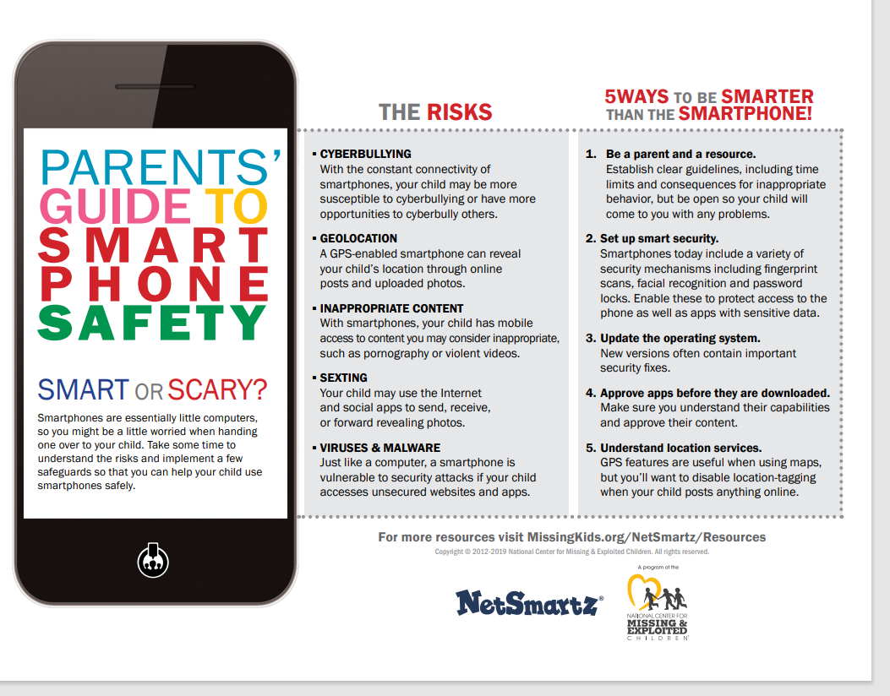

Slide 13
